Slide 1

Exploring Contextual Embeddings for Twitter Sentiment Analysis: A Comparative Study of NLP (Natural Language Processing)
Ishu¹, Mohammad Arman², Mohd Shoyeb Sheakh³
^{[1]} Data-Science Department, Noida Institute of Engineering and Technology, Greater Noida, India
^{[2]} Data-Science Department, Noida Institute of Engineering and Technology, Greater Noida, India
^{[3]} Data-Science Department, Noida Institute of Engineering and Technology, Greater Noida, India

Slide 2

Introduction to Twitter Sentiment Analysis
Twitter sentiment analysis involves understanding the emotions and opinions expressed in tweets. It's a valuable tool for businesses to gauge public opinion, for individuals to understand trends, and for researchers to study social behavior. The analysis allows for the identification of positive, negative, and neutral sentiments. Furthermore, sentiment analysis can be used to predict market trends, identify customer satisfaction levels, and even analyze political opinions. This area of study plays a pivotal role in understanding and utilizing the vast amount of data generated on Twitter each day.
Members Involved : Ishu , Arman , Shoaib
CSDS-VIth-A

Slide 3
Importance of NLP and Machine Learning Models
Natural Language Processing (NLP)
Machine Learning Models
NLP is crucial for sentiment analysis as it enables the understanding, interpretation, and manipulation of human language. Through NLP, machines are able to understand, interpret, and respond to human language in meaningful ways, paving the way for sentiment analysis in the realm of social media.
Machine learning models are vital for analyzing vast amounts of textual data, enabling the identification of patterns, trends, and sentiments. These models provide the capability to detect sentiment, classify opinions, and make predictions based on the content of tweets, making them indispensable in the field of sentiment analysis on Twitter.

Slide 4
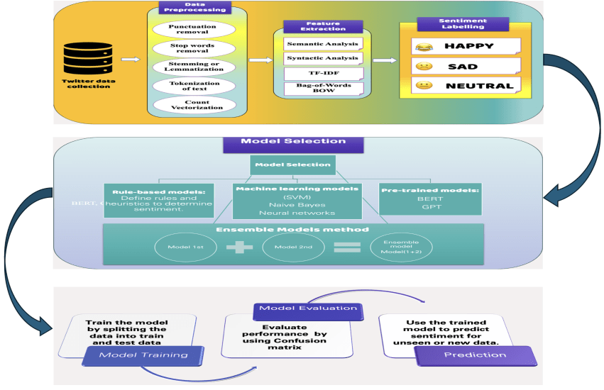

Slide 5
Data Collection and Preprocessing
1
APIs for Data Collection
2
Data Cleaning and Preprocessing
3
Sentiment Lexicons
Utilizing pre-existing sentiment lexicons or creating custom ones to attribute sentiment scores to words within the tweets, facilitating deeper sentiment analysis.
Accessing Twitter's API or using third-party API services to collect the desired tweets for analysis, ensuring that the collected data is comprehensive and diverse.
Utilizing techniques such as tokenization, normalization, and removing stop words to prepare the tweet data for further analysis, ensuring accurate and reliable results.

Slide 6
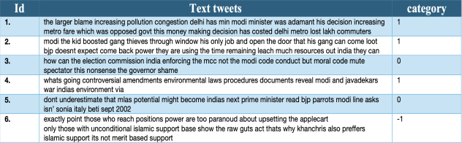
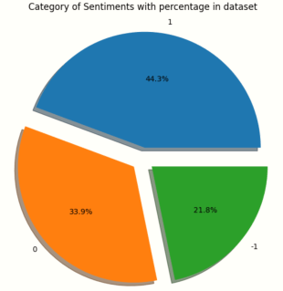
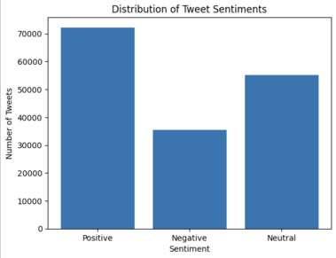
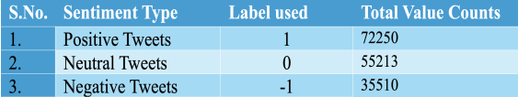
Dataset Understanding
Sample of data
Visual representation of the category of sentiments

Slide 7
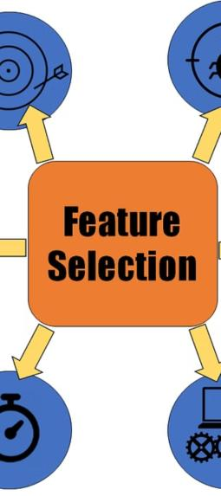


Feature Engineering and Selection
Text Features
Engineering features from the tweet text itself, including word frequency, sentiment score, and linguistic complexity, to capture the most relevant information for analysis.
Contextual Features
Selecting contextual features such as user engagement, location, and time of posting to bolster the sentiment analysis, considering the nuances and context behind tweets.

Slide 8
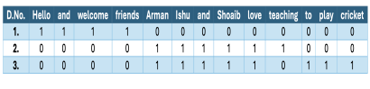
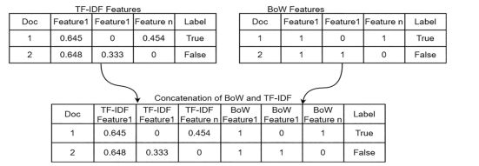


TF-IDF
Attributes section and encoding
BoW
TF-IDF stands for Term Frequency-Inverse Document Frequency. It is a numerical statistic used in natural language processing and information retrieval to reflect the importance of a term in a document relative to a collection of documents.
﻿﻿﻿Hello and welcome friends
﻿﻿﻿Arman, Ishu and Shoaib love teaching
﻿﻿﻿Arman, Ishu and Shoaib love to play cricket
$$TF\left(t,d\right)= \frac{frequency \left(t , d\right)}{total word count\left(d\right)}$$
$$IDF\left(t,d\right)=\left(\frac{total number of documents\left(d\right)in corpus}{total number of documents in corpus containing term\left(t,d\right)}\right)$$
TF-IDF is the term we get after multiplying the TF and IDF scores.
TF-IDF = tf_{(t,d)} * log( idf_{(t,d)} )

Slide 9
Building NLP and Machine Learning Models
Algorithm Selection
Training and Validation
Choosing the appropriate machine learning algorithms such as Naive Bayes, Support Vector Machines (SVM), or Recurrent Neural Networks (RNN) to train sentiment analysis models.
Using labeled tweet datasets to train and validate the models, ensuring optimal performance and accuracy in classifying sentiments.

Slide 10
Feature Extraction and Model Training
1
Feature Extraction
2
Model Selection
3
Training and Testing
Choosing appropriate algorithms for sentiment classification:
Naive Bayes
Support Vector Machines
Random Forests
Catboost Model
To train the Model with training data and then testing using Test Data 80:20 ratio
ransforming text data into numerical representations:Bag-of-Words model
TF-IDF (Term Frequency-Inverse Document Frequency)
Word Embeddings

Slide 11
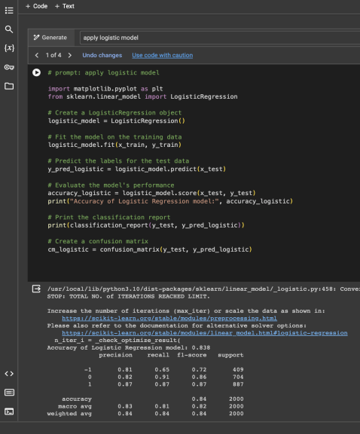
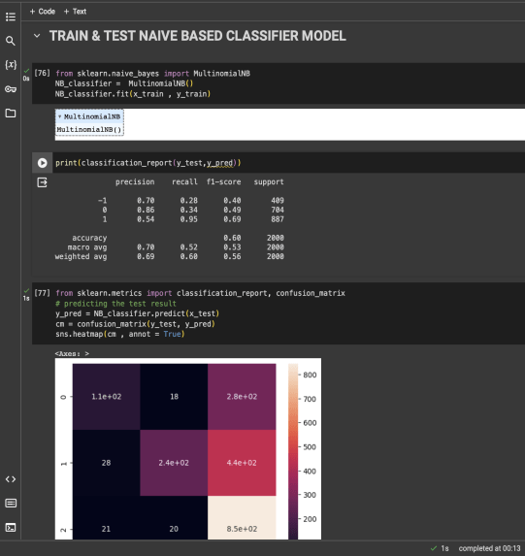
Logistic Regression
NAÏVE BAYES ALGORITHM

Slide 12
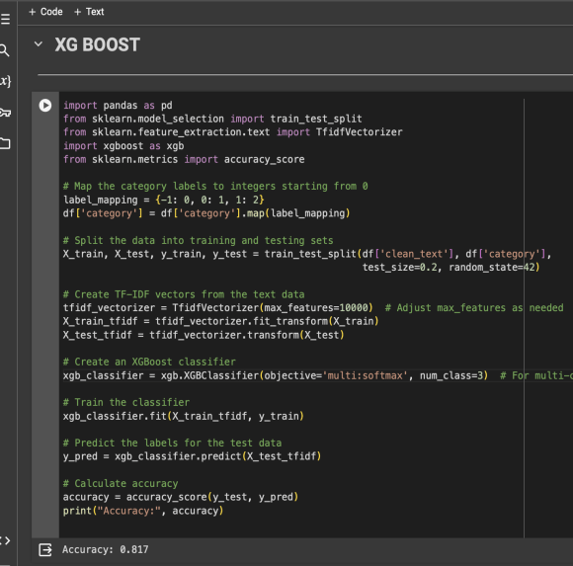
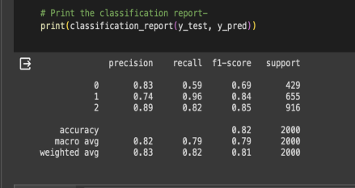
XG-Boost, short for Extreme Gradient Boosting, is a powerful machine learning algorithm known for its speed and performance in supervised learning tasks. It operates on the principle of ensemble learning, where multiple weak learners (typically decision trees) are combined sequentially to create a strong learner.

Slide 13
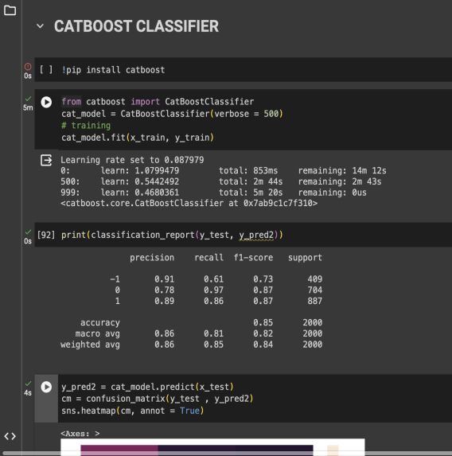
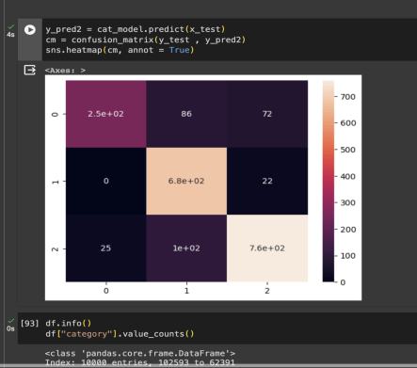
Cat-Boost is a gradient boosting algorithm designed for high-performance machine learning tasks. It excels in handling categorical features without the need for extensive preprocessing, while also providing efficient training speed and robustness to noisy data.

Slide 14

We Are basically working on Deep learning techniques
Working on RNN and LSTM And BERT is in Progress…………

Slide 15
Evaluation Metrics and Performance
Precision
Measuring the accuracy of the positive sentiment predictions
Recall
Evaluating the ability of the model to identify positive sentiments within the dataset
F1 Score
Providing a balance between precision and recall for sentiment classification

Slide 16
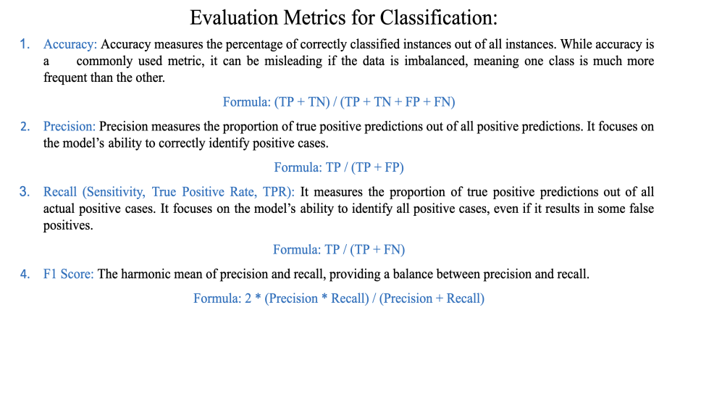
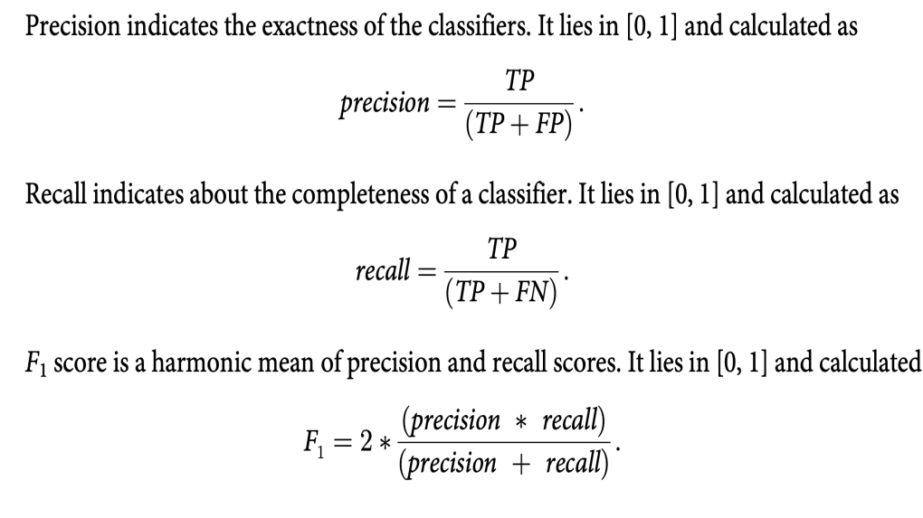
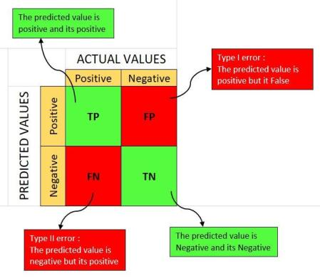
Precision and recall.

Slide 17
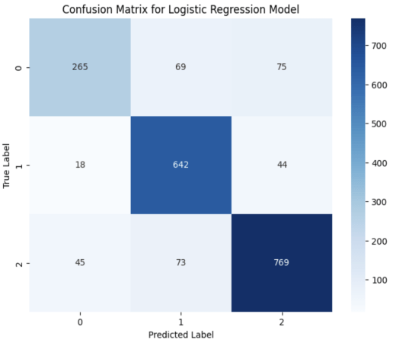
CONFUSION MATRIX
RESULT ANALYSIS

Slide 18
Evaluation and Interpretation
1
Evaluation
2
Interpretation and Analysis
Assessing model performance using evaluation metrics:
Accuracy, Precision, Recall, F1-score
Cross-validation techniques
Handling imbalanced datasets
Comparison with baseline models or human annotators
Visualizing sentiment distribution:
Word clouds, bar charts, heatmaps
Identifying influential factors:
Keywords, topics, user demographics
Drawing insights and implications from the results

Slide 19
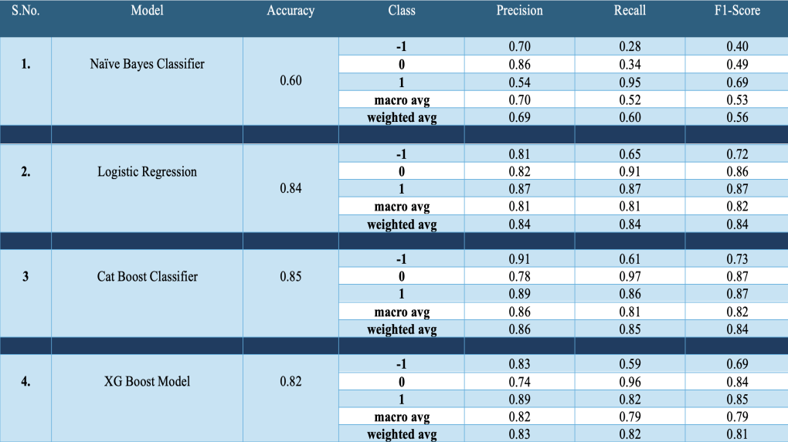

Slide 20
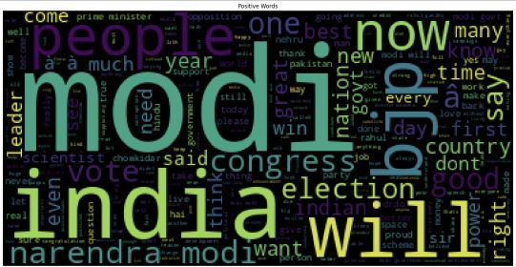
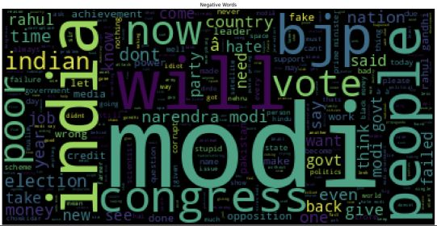
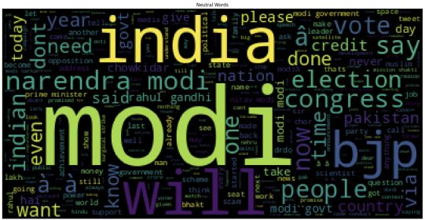
Word Cloud Analysis
Positive Word Cloud
Negative Word Cloud
Neutral Word Cloud

Slide 21
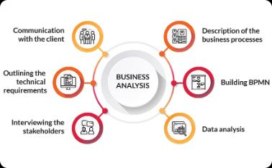
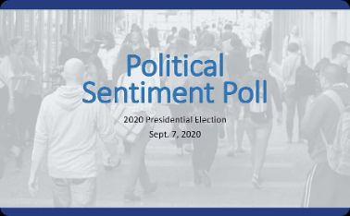

Real-world Applications and Case Studies
Market Analysis
Political Analysis
Healthcare Insights
Utilizing sentiment analysis to understand consumer sentiment towards products, brands, and trends, aiding in informed business decisions and marketing strategies.
Applying sentiment analysis to gauge public opinion, reactions to policies, and the sentiment surrounding political leaders and parties for strategic decision-making.
Using sentiment analysis to understand patient experiences, sentiments towards healthcare providers, and public health sentiments to drive improvements in healthcare services and policies.

Slide 22



Conclusion and Future Developments
Innovation
Industry Growth
Global Adoption
Continued innovation in NLP and machine learning technologies to enhance sentiment analysis and capture more nuanced sentiments from tweets.
Anticipating exponential growth in the integration of sentiment analysis tools across various industries for informed decision-making and trend analysis.
Expecting wider adoption of sentiment analysis on Twitter as a standard practice for understanding public sentiment and behavior on a global scale.

Slide 23



